Slide 1



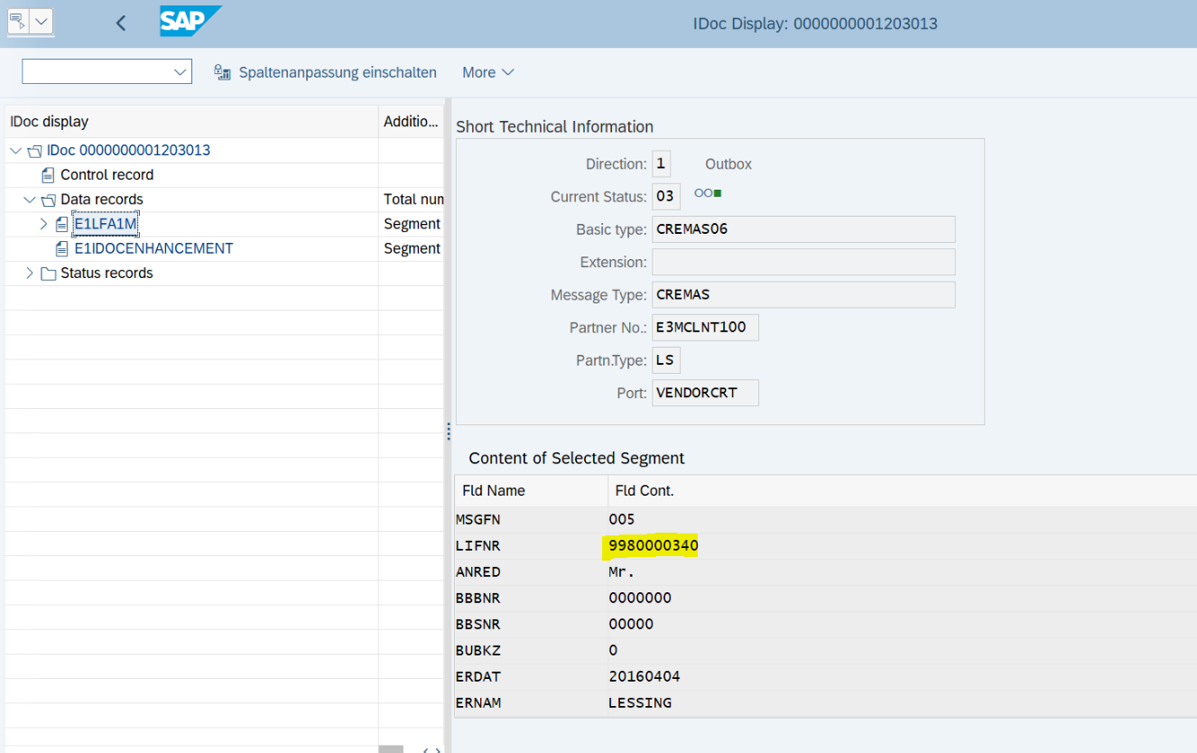
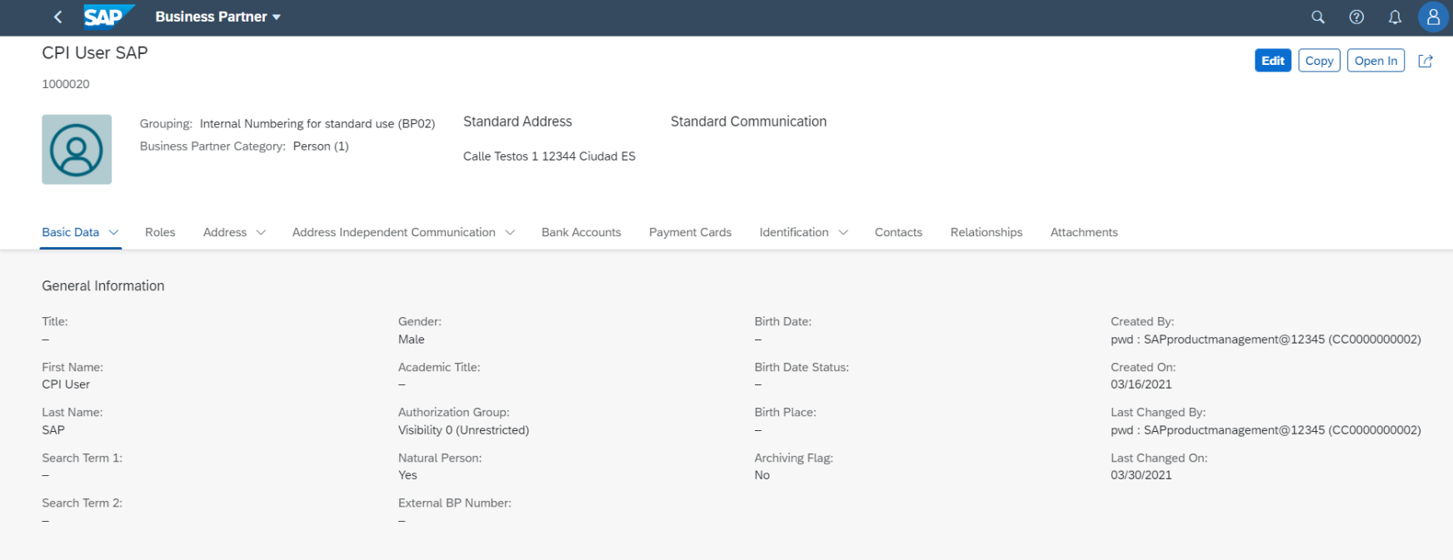
Business Partner Replication- Using Cloud Integration Middleware with SAP S/4HANA Cloud Public Edition
The scope item 1RO provides direct integration for master data.
Customers may expect middleware for all interfaces subjected to their security policy.
Value Proposition
  This accelerator will reduce the implementation timeline drastically
  Master data harmonization across the entire enterprise.
  Easy to enhance based on customer requirement
  Capabilities
  Replication of customer & vendor as business partner from SAP S/4HANA Cloud Private Edition to SAP S/4HANA Cloud Public Edition using cloud integration (CI) i-flow.
  Trouble shooting based on AIF(Application Integration Framework) monitor
Tier 1
SAP BTP
Tier 2

